Slide 1
Glycolysis
Part 1 - Overview: Making Energy From Sugar
Notes:
Welcome to our five part series on Glycolysis. In part 1 of the series, we will provide you with an historical overview of glycolysis and a brief introduction to the 10 enzymatic reactions in the pathway.

Slide 2
Remember your Free Energy!
For a reaction to occur spontaneously:
ΔG, the change in free energy is negative
Recall that :
ΔG = ΔG^{o’} + RTln ------------
Standard Free Energy Change
Products
[C][D]
[A][B]
Reactants
Notes:
Before we begin our journey into the glycolytic pathway, I just wanted to remind you about the concept of free energy within reactions. For a reaction to be spontaneous, the change in the free energy within the system must be negative. From the equation above, you can see that the change in free energy of a reaction is dependent on concentration of the reactants and the products, as well as the temperature within the system.

Slide 3
Making Reactions Occur Spontaneously
ΔG values are dependent on the concentrations of reactants and products.
Thus, reducing the amount of products present within a cell can help drive a reaction forward
ΔG = ΔG^{o’} + RTln ------------
[C][D]
[A][B]
Notes:
Some reactions that occur within the metabolic pathways that we will investigate are not favored. Thus, it is necessary to drive the reaction to become spontaneous by either coupling the reaction with a spontaneous reaction that can generate enough free energy to drive the nonspontaneous reaction forward, or by using Le Chatlier’s principle and remove the products from the enzyme’s area as soon as they are made. This will help drive the reaction in the forward direction as it will reestablish equilibrium. In this way, a small amount of product can be formed spontaneously. Continued removal of product or excess of reactant, will drive the reaction forward.

Slide 4
Thermodynamically unfavorable reactions can be driven by a favorable reaction
The overall free-energy change for a chemically coupled series of reactions is equal to the sum of the free energy changes of the individual steps
A B + C ΔG^{o’} = +21 kJmol⁻¹
B D ΔG^{o’} = -34 kJmol⁻¹
A C + D ΔG^{o’} = -13 kJmol⁻¹
Notes:
This schematic shows the coupling of two reactions. The top reaction is nonspontaneous with a positive change in free energy of 21 kJ/mol. This reaction can be driven in the forward direction, by coupling it with a strongly spontaneous reaction that releases -34 kJ/mol. The overall net reaction has a negative change in free energy and is spontaneous

Slide 5
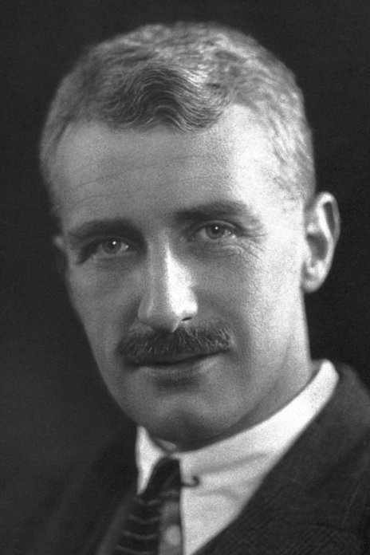
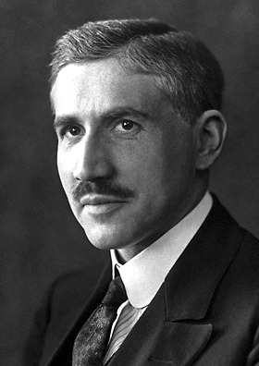
Nobel Prize (1922)
Archibald V. Hill
Otto Fritz Meyerhof
Photos from Nobel Prize.Org
Notes:
We have spent a lot of time over the last week discussing the myriad of ways that our bodies use and need energy. The metabolic reactions of carbohydrates and other food molecules play an important role in generating this energy in the form of ATP. For carbohydrates, this begins with the metabolic process known as glycolysis (or the breakdown,’lysis’, of sugars, ‘glyco’) At the end of the 1910s Otto Meyerhof mapped some of these metabolic conversions by measuring heat trends and oxygen consumption in frog muscles. When the muscle is working, lactic acid is formed from carbohydrates, and Otto Meyerhof showed that during recovery, this is followed partly by the burning of lactic acid and partly by reprocessing of lactic acid to carbohydrates.
Concurrently, Archibald Hill was also outlining these processes in the muscles from frogs. In opposition to the prevailing view that mechanical movement and chemical processes were parallel sequences, Hill was able to show through measurements of heat generated by the mechanical processes that these were delayed in relation to the movements. The chemical sequence consists of a work phase, which is not dependent on oxygen supply, and a recovery phase, when oxygen is required. Together, their work has opened the door to understanding aerobic and anaerobic metabolism beginning with the process of glycolysis. They both shared the Nobel Prize in Physiology and Medicine in 1922 for their work in these processes.

Slide 6
Overview of Glycolysis
or in yeast…alcoholic fermentation
Ethanol
Figure modified from Kim, Y. et al (2011) PLoS ONE 6(12):e28293
Notes:
We will begin this section with an overview of the glycolytic pathway. The glycolytic pathways consists of 10 enzymatic steps that convert glucose to pyruvate. This conversion generates a small amount of energy. The pyruvate can then be converted to lactic acid (lactate) in vertebrates or to ethanol in yeast in an anaerobic (or oxygen-independent) pathway or it can be fully oxidized to carbon dioxide in an aerobic (or oxygen-requiring) pathway that takes place within the mitochondria (which is shown in green above). Aerobic oxidation yields about 18 times as much energy as the anaerobic pathways causing them to be favored over anaerobic pathways. In fact, most animal tissues can only survive short anaerobic bursts that occur in isolation and don’t involve the entire organism. The aerobic pathway is required to sustain life. Yeast also prefer to grow using the aerobic, mitochondrial pathway. However, if oxygen is unavailable, yeast and other fungi can switch to anaerobic growth and produce ethanol as a byproduct. The production of alcoholic beverages through this fermentation process is quite popular.

Slide 7
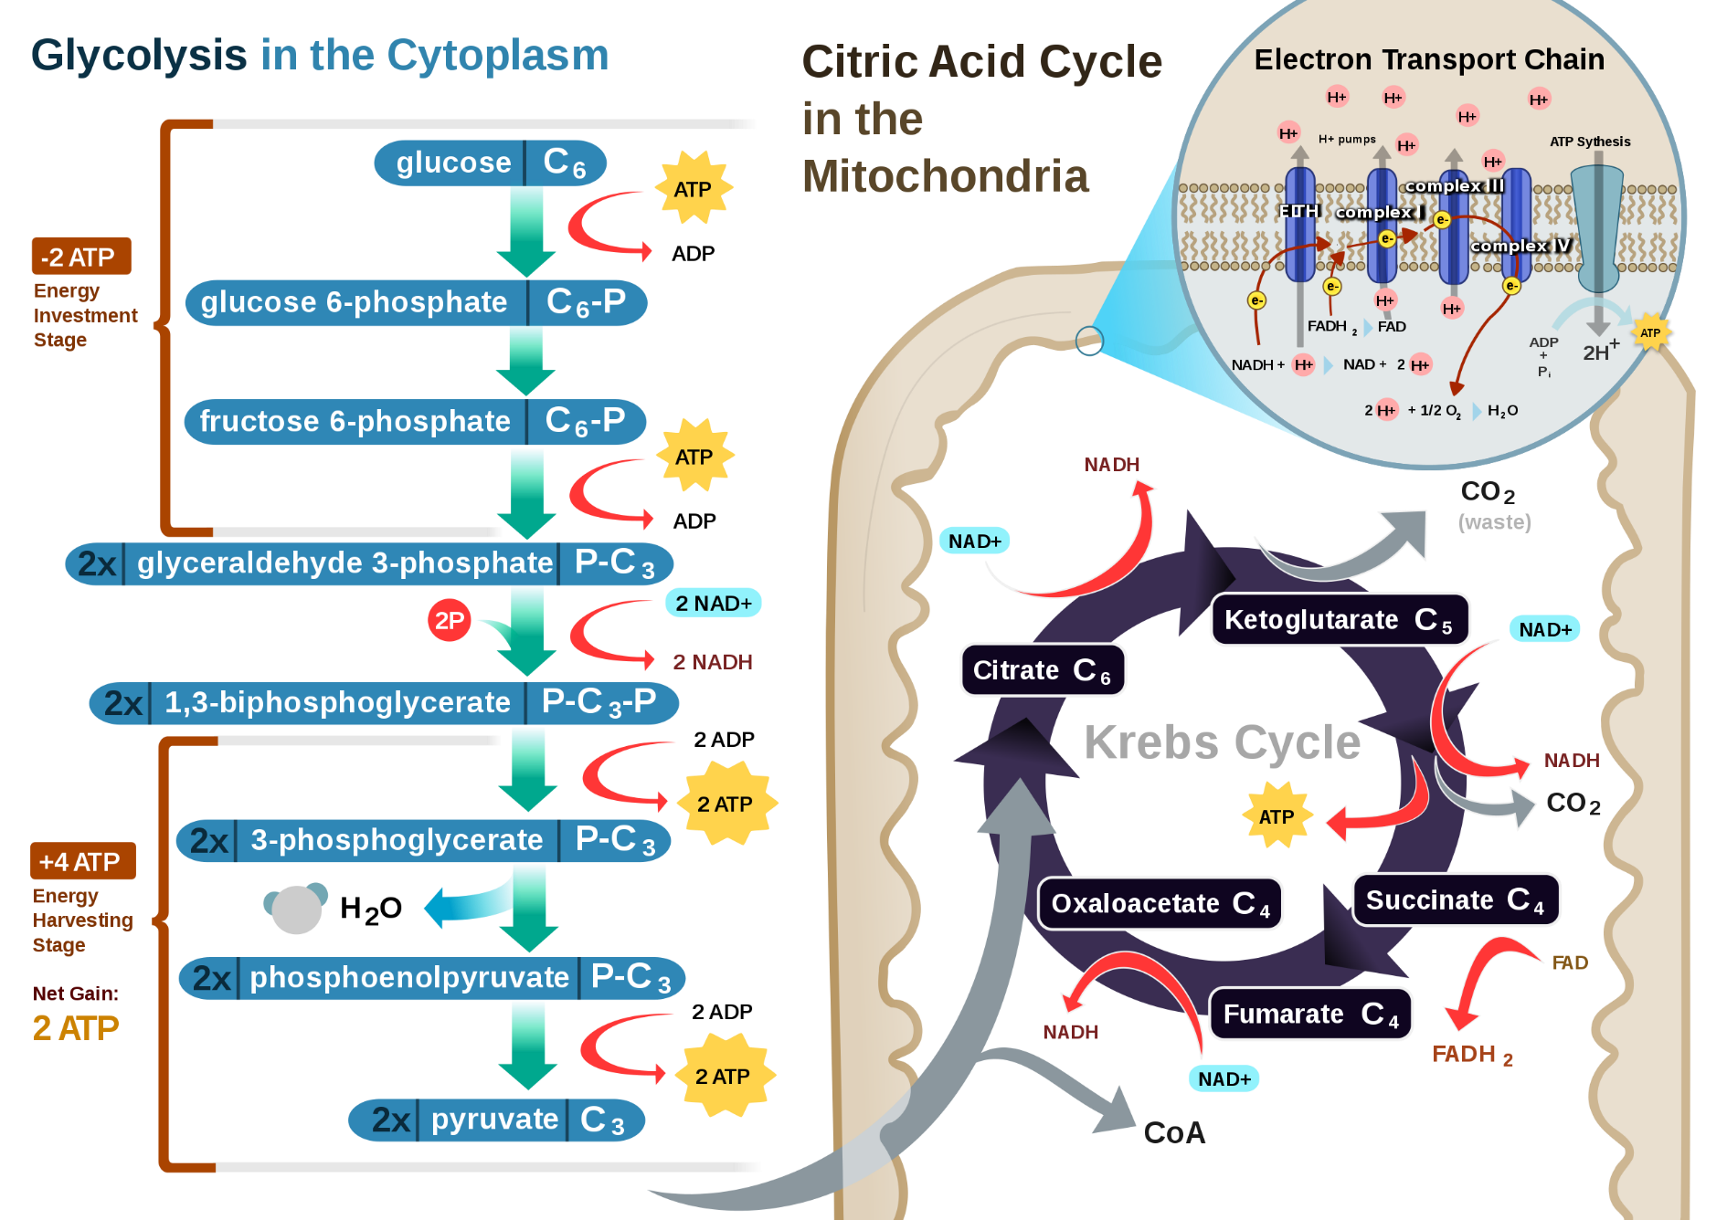
Aerobic Pathway
Figure from RegisFrey
Notes:
A summary of the glycolytic pathway, metabolizing glucose to pyruvate, is shown on the left hand side in blue. During aerobic metabolism, pyruvate would be converted to acetyl-CoA where it would then enter into the Kreb cycle within the matrix of the mitochondria. Future lectures will focus on the reactions inside the mitochondria. Our focus for these lectures will be on the cytosolic reactions of the glycolytic pathway.

Slide 8
Overview of Glycolysis
3
4
1
2
Fructose Bisposophate Aldolase
Phosphofructo-
Kinase-1
Mg²⁺
Dihydroxyacetone
Phosphate
Hexokinase
Mg²⁺
Phosphoglucose Isomerase
5
Triose Phosphate Isomerase
Glucose
Glucose-6-phosphate
Fructose-6-phosphate
Fructose-1,6-bisphosphate
Glyceraldehyde 3-phosphate
NAD⁺
Pi
6
Glyceraldehyde
3-phosphate Dehydrogenase
10
NADH
+ H⁺
9
8
7
Pyruvate
Kinase
Mg²⁺
Phosphoglycerate Mutase
Enolase
Phosphoglycerate Kinase
Mg²⁺
Pyruvate
Phosphoenol-
Pyruvate
2-Phosphoglycerate
3-Phosphoglycerate
1,3-Bisphosphoglycerate
Figure modified from YassineMrabet
Notes:
This is a summary of the 10 metabolic reactions of the glycolytic pathway. The pathway can be broken down into two major sections: (1) the energy consuming reactions and the (2) energy generating reactions. People always say the old adage that ‘It takes money to make money’. The same can be thought about the glycolytic pathway. The first section requires an investment of energy, in order to generate energy in the second half of the reaction pathway.

Slide 9
First Half of Glycolysis – Energy Requiring Steps
3
4
1
2
Fructose Bisposophate Aldolase
Phosphofructo-
Kinase-1
Mg²⁺
Dihydroxyacetone
Phosphate
Hexokinase
Mg²⁺
Phosphoglucose Isomerase
5
Triose Phosphate Isomerase
Glucose
Glucose-6-phosphate
Fructose-6-phosphate
Fructose-1,6-bisphosphate
Glyceraldehyde 3-phosphate
Figure modified from YassineMrabet
Notes:
Here is an overview of the first half of the glycolytic reactions. These are the energy requiring steps. From our lectures on glycogen metabolism, you have already been introduced to three of the five enzymes utilized in this pathway: The Hexokinase in step 1, The Phosphoglucose Isomerase in step 2, and the Triose Phosphate Isomerase in step 5. Recall that the isomerase enzymes worked via an ene-diol intermediate and that the phosphoglucose isomerase first bound to the ring closed form of the sugar, but mediated ring opening during the reaction mechanism. Both the hexokinase in step 1 and the phosphofructokinase in step 3 are important enzymes in the regulation of the glycolytic pathway and will be discussed in more detai. Text modified from Clark, M.A., Douglas, M., and Choi, J. (2018) Biology 2e at openstax.org

Slide 10
Glycolysis – Step 1
1
3
4
1
2
Fructose Bisposophate Aldolase
Hexokinase
Mg²⁺
Dihydroxyacetone
Phosphate
Hexokinase
Mg²⁺
Phosphoglucose Isomerase
Phosphofructo-
kinase
Mg²⁺
5
Triose Phosphate Isomerase
Glucose
Glucose-6-phosphate
Fructose-6-phosphate
Fructose-1,6-bisphosphate
Glyceraldehyde 3-phosphate
Glucose
Glucose-6-phosphate
Figure modified from YassineMrabet
Notes:
Step 1. The first step in glycolysis is catalyzed by hexokinase, an enzyme with broad specificity that catalyzes the phosphorylation of six-carbon sugars. Hexokinase phosphorylates glucose using ATP as the source of the phosphate, producing glucose-6-phosphate, a more reactive form of glucose. This reaction prevents the phosphorylated glucose molecule from continuing to interact with the GLUT proteins, and it can no longer leave the cell because the negatively charged phosphate will not allow it to cross the hydrophobic interior of the plasma membrane. Do note that both of these sugar forms (the free sugar and the phosphorylated version) are shifting back and forth between the ring-closed and ring-opened conformation. The enzymes involved in the reactions are specific for one form or the other.
Text from Clark, M.A., Douglas, M., and Choi, J. (2018) Biology 2e at openstax.org

Slide 11
Glycolysis – Step 2
2
3
4
1
2
Fructose Bisposophate Aldolase
Phosphoglucose
Isomerase
Dihydroxyacetone
Phosphate
Hexokinase
Mg²⁺
Phosphoglucose Isomerase
Phosphofructo-
kinase
Mg²⁺
5
Triose Phosphate Isomerase
Glucose
Glucose-6-phosphate
Fructose-6-phosphate
Fructose-1,6-bisphosphate
Glyceraldehyde 3-phosphate
Glucose-6-phosphate
Fructose-6-phosphate
Figure modified from YassineMrabet
Notes:
Step 2. In the second step of glycolysis, an isomerase converts glucose-6-phosphate into one of its isomers, fructose-6-phosphate (this isomer has a phosphate attached at the location of the sixth carbon of the ring). An isomerase is an enzyme that catalyzes the conversion of a molecule into one of its isomers. (This change from phosphoglucose to phosphofructose allows the eventual split of the sugar into two three-carbon molecules.)
Text from Clark, M.A., Douglas, M., and Choi, J. (2018) Biology 2e at openstax.org

Slide 12
Glycolysis – Step 3
3
3
4
1
2
Fructose Bisposophate Aldolase
Phosphofructo-
kinase
Mg²⁺
Dihydroxyacetone
Phosphate
Hexokinase
Mg²⁺
Phosphoglucose Isomerase
Phosphofructokinase-1
Mg²⁺
5
Triose Phosphate Isomerase
Glucose
Glucose-6-phosphate
Fructose-6-phosphate
Fructose-1,6-bisphosphate
Fructose-
1,6-bisphosphate
Glyceraldehyde 3-phosphate
Fructose-6-phosphate
Figure modified from YassineMrabet
Notes:
Step 3. The third step is the phosphorylation of fructose-6-phosphate, catalyzed by the enzyme phosphofructokinase. A second ATP molecule donates a high-energy phosphate to fructose-6-phosphate, producing fructose-1,6-bisphosphate. In this pathway, phosphofructokinase is a rate-limiting enzyme. It is active when the concentration of ADP is high; it is less active when ADP levels are low and the concentration of ATP is high. Thus, if there is “sufficient” ATP in the system, the pathway slows down. This is a type of end product inhibition, since ATP is the end product of glucose catabolism.
Text from Clark, M.A., Douglas, M., and Choi, J. (2018) Biology 2e at openstax.org

Slide 13
Glycolysis – Step 4
Dihydroxyacetone
phosphate
4
3
4
Fructose Bisphosphate
Aldolase
1
2
Fructose Bisposophate Aldolase
Phosphofructo-
kinase
Mg²⁺
Dihydroxyacetone
Phosphate
Hexokinase
Mg²⁺
Phosphoglucose Isomerase
5
Triose Phosphate Isomerase
Glucose
Glucose-6-phosphate
Fructose-6-phosphate
Fructose-1,6-bisphosphate
Fructose-
1,6-bisphosphate
Glyceraldehyde 3-phosphate
Glyceraldehyde
3-phosphate
Figure modified from YassineMrabet
Notes:
Step 4. The newly added high-energy phosphates further destabilize fructose-1,6-bisphosphate. The fourth step in glycolysis employs an enzyme, aldolase, to cleave fructose-1,6-bisphosphate into two three-carbon isomers: dihydroxyacetone phosphate and glyceraldehyde-3-phosphate.
Text from Clark, M.A., Douglas, M., and Choi, J. (2018) Biology 2e at openstax.org

Slide 14
Glycolysis – Step 5
5
3
4
1
2
Triose Phosphate
Isomerase
Fructose Bisposophate Aldolase
Phosphofructo-
kinase
Mg²⁺
Dihydroxyacetone
Phosphate
Hexokinase
Mg²⁺
Phosphoglucose Isomerase
5
Triose Phosphate Isomerase
Glucose
Glucose-6-phosphate
Fructose-6-phosphate
Fructose-1,6-bisphosphate
Glyceraldehyde
3-phosphate
Glyceraldehyde 3-phosphate
Dihydroxyacetone
phosphate
Figure modified from YassineMrabet
Notes:
Step 5. In the fifth step, an isomerase transforms the dihydroxyacetone-phosphate into its isomer, glyceraldehyde-3-phosphate. Thus, the pathway will continue with two molecules of a glyceraldehyde-3-phosphate. At this point in the pathway, there is a net investment of energy from two ATP molecules in the breakdown of one glucose molecule.
Text from Clark, M.A., Douglas, M., and Choi, J. (2018) Biology 2e at openstax.org

Slide 15
Second Half of Glycolysis – Energy Generating
Glyceraldehyde 3-phosphate
NAD⁺
Pi
6
Glyceraldehyde
3-phosphate Dehydrogenase
10
NADH
+ H⁺
9
8
7
Pyruvate
Kinase
Mg²⁺
Phosphoglycerate Mutase
Enolase
Phosphoglycerate Kinase
Mg²⁺
Pyruvate
Phosphoenol-
Pyruvate
2-Phosphoglycerate
3-Phosphoglycerate
1,3-Bisphosphoglycerate
Figure modified from YassineMrabet
Notes:
So far, glycolysis has cost the cell two ATP molecules and produced two small, three-carbon sugar molecules. Both of these molecules will proceed through the second half of the pathway, and sufficient energy will be extracted to pay back the two ATP molecules used as an initial investment and produce a profit for the cell of two additional ATP molecules and two even higher-energy NADH molecules. Text from Clark, M.A., Douglas, M., and Choi, J. (2018) Biology 2e at openstax.org

Slide 16
Second Half of Glycolysis – Energy Generating
6
Glyceraldehyde 3-phosphate
Glyceraldehyde
3-Phosphate
Dehydrogenase
NAD⁺
Pi
6
Glyceraldehyde
3-phosphate Dehydrogenase
10
NADH
+ H⁺
9
8
7
Pyruvate
Kinase
Mg²⁺
Phosphoglycerate Mutase
Enolase
Phosphoglycerate Kinase
Mg²⁺
NAD⁺
Pi
NADH
+ H⁺
Pyruvate
Phosphoenol-
Pyruvate
2-Phosphoglycerate
3-Phosphoglycerate
Glyceraldehyde
3-phosphate
1,3-Bisphosphoglycerate
1,3-Bisphosphoglycerate
Figure modified from YassineMrabet
Notes:
Step 6. The sixth step in glycolysis oxidizes the sugar (glyceraldehyde-3-phosphate), extracting high-energy electrons, which are picked up by the electron carrier NAD⁺, producing NADH. The sugar is then phosphorylated by the addition of a second phosphate group, producing 1,3-bisphosphoglycerate. Note that the second phosphate group does not require another ATP molecule. Here again is a potential limiting factor for this pathway. The continuation of the reaction depends upon the availability of the oxidized form of the electron carrier, NAD⁺. Thus, NADH must be continuously oxidized back into NAD⁺ in order to keep this step going. If NAD⁺ is not available, the second half of glycolysis slows down or stops. If oxygen is available in the system, the NADH will be oxidized readily, though indirectly, and the high-energy electrons from the hydrogen released in this process will be used to produce ATP. In an environment without oxygen, an alternate pathway (fermentation) can provide the oxidation of NADH to NAD⁺. Text from Clark, M.A., Douglas, M., and Choi, J. (2018) Biology 2e at openstax.org

Slide 17
Second Half of Glycolysis – Energy Generating
7
Glyceraldehyde 3-phosphate
3-Phosphoglycerate
Kinase
Mg²⁺
NAD⁺
Pi
6
Glyceraldehyde
3-phosphate Dehydrogenase
10
NADH
+ H⁺
9
8
7
Pyruvate
Kinase
Mg²⁺
Phosphoglycerate Mutase
Enolase
Phosphoglycerate Kinase
Mg²⁺
Pyruvate
Phosphoenol-
Pyruvate
2-Phosphoglycerate
3-Phosphoglycerate
3-Phosphoglycerate
1,3-Bisphosphoglycerate
1,3-Bisphosphoglycerate
Figure modified from YassineMrabet
Notes:
Step 7. In the seventh step, catalyzed by phosphoglycerate kinase (an enzyme named for the reverse reaction), 1,3-bisphosphoglycerate donates a high-energy phosphate to ADP, forming one molecule of ATP. (This is an example of substrate-level phosphorylation.) A carbonyl group on the 1,3-bisphosphoglycerate is oxidized to a carboxyl group, and 3-phosphoglycerate is formed. Text from Clark, M.A., Douglas, M., and Choi, J. (2018) Biology 2e at openstax.org

Slide 18
Second Half of Glycolysis – Energy Generating
Glyceraldehyde 3-phosphate
8
NAD⁺
Pi
6
Phosphoglycerate
Mutase
Glyceraldehyde
3-phosphate Dehydrogenase
10
NADH
+ H⁺
9
8
7
Pyruvate
Kinase
Mg²⁺
Phosphoglycerate Mutase
Enolase
Phosphoglycerate Kinase
Mg²⁺
Pyruvate
Phosphoenol-
Pyruvate
2-Phosphoglycerate
3-Phosphoglycerate
3-Phosphoglycerate
2-Phosphoglycerate
1,3-Bisphosphoglycerate
Figure modified from YassineMrabet
Notes:
Step 8. In the eighth step, the remaining phosphate group in 3-phosphoglycerate moves from the third carbon to the second carbon, producing 2-phosphoglycerate (an isomer of 3-phosphoglycerate). The enzyme catalyzing this step is a mutase (isomerase). Text from Clark, M.A., Douglas, M., and Choi, J. (2018) Biology 2e at openstax.org

Slide 19
Second Half of Glycolysis – Energy Generating
Glyceraldehyde 3-phosphate
9
NAD⁺
Pi
6
Glyceraldehyde
3-phosphate Dehydrogenase
Enolase
NADH
+ H⁺
10
8
9
7
Pyruvate
Kinase
Mg²⁺
Phosphoglycerate Mutase
Enolase
Phosphoglycerate Kinase
Mg²⁺
Phosphoenol-
Pyruvate
Pyruvate
2-Phosphoglycerate
3-Phosphoglycerate
2-Phosphoglycerate
Phosphoenolpyruvate
1,3-Bisphosphoglycerate
Figure modified from YassineMrabet
Notes:
Step 9. Enolase catalyzes the ninth step. This enzyme causes 2-phosphoglycerate to lose water from its structure; this is a dehydration reaction, resulting in the formation of a double bond that increases the potential energy in the remaining phosphate bond and produces phosphoenolpyruvate (PEP). Text from Clark, M.A., Douglas, M., and Choi, J. (2018) Biology 2e at openstax.org

Slide 20
Second Half of Glycolysis – Energy Generating
Glyceraldehyde 3-phosphate
10
Pyruvate
Kinase
NAD⁺
Pi
6
Glyceraldehyde
3-phosphate Dehydrogenase
10
Mg²⁺
NADH
+ H⁺
8
9
8
7
Pyruvate
Kinase
Mg²⁺
Phosphoglycerate Mutase
Enolase
Phosphoglycerate Kinase
Mg²⁺
Pyruvate
Phosphoenol-
Pyruvate
Phosphoenolpyruvate
3-Phosphoglycerate
2-Phosphoglycerate
Pyruvate
1,3-Bisphosphoglycerate
Figure modified from YassineMrabet
Notes:
Step 10. The last step in glycolysis is catalyzed by the enzyme pyruvate kinase (the enzyme in this case is named for the reverse reaction of pyruvate’s conversion into PEP) and results in the production of a second ATP molecule by substrate-level phosphorylation and the compound pyruvic acid (or its salt form, pyruvate). Many enzymes in enzymatic pathways are named for the reverse reactions, since the enzyme can catalyze both forward and reverse reactions (these may have been described initially by the reverse reaction that takes place in vitro, under nonphysiological conditions). Text from Clark, M.A., Douglas, M., and Choi, J. (2018) Biology 2e at openstax.org

Slide 21
Energy Generation from Glycolysis
Energy Using stage = 2 ATP
Energy Generating Stage = 4 ATP
Net Gain per Glucose = 2ATP
Also Generate 2 electron carriers (2 NADH + 2H⁺)
Notes:
Overall, glycolysis begins with glucose and produces two pyruvate molecules, four new ATP molecules, and two molecules of NADH. (Note: two ATP molecules are used in the first half of the pathway to prepare the six-carbon ring for cleavage, so the cell has a net gain of two ATP molecules and two NADH molecules for its use). If the cell cannot catabolize the pyruvate molecules further, it will harvest only two ATP molecules from one molecule of glucose. Mature mammalian red blood cells do not have mitochondria and thus are not capable of aerobic respiration—the process in which organisms convert energy in the presence of oxygen—Therefore, glycolysis is their sole source of ATP. If glycolysis is interrupted, these cells lose their ability to maintain their sodium-potassium pumps, and will die.
The last step in glycolysis will not occur if pyruvate kinase, the enzyme that catalyzes the formation of pyruvate, is not available in sufficient quantities. In this situation, the entire glycolysis pathway will proceed, but only two ATP molecules will be made in the second half. Thus, pyruvate kinase is a rate-limiting enzyme for glycolysis.
Text from Clark, M.A., Douglas, M., and Choi, J. (2018) Biology 2e at openstax.org

