Slide 1
Proposed Syllabus Inclusion

Slide 2
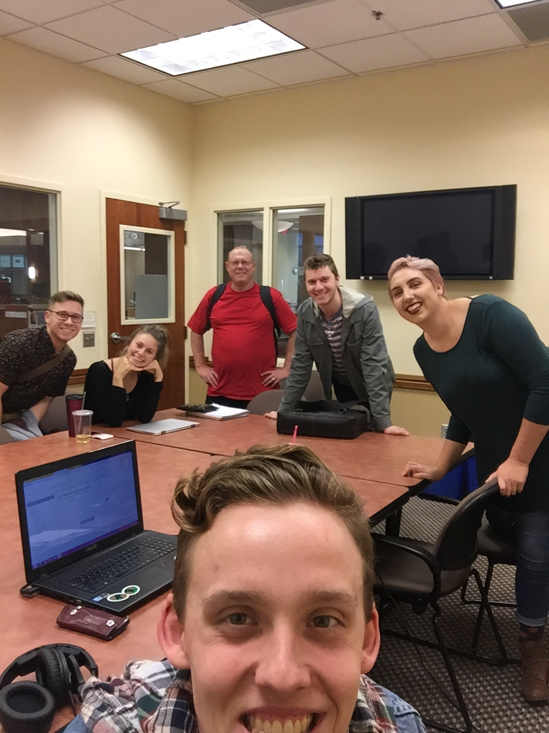
Who Are We?

Slide 3
Our Focus
Homelessness and poverty among Polk County inhabitants.
Raising Awareness
Combating Stigmas
Making resources more known and accessible

Slide 4
Hunger Among College Students
Article: Poverty Is Largely Invisible Among College Students
Sara Goldrick-Rab, PhD
November 7, 2017
“Since 2008, my team’s research on how students finance college has revealed that the main barrier to degree completion isn’t tuition; it’s having a place to sleep and enough food to eat. The best estimates suggest that food insecurity affects as many as 1 in 2 college students—much higher than the rate in the general population. Just as many struggle with housing insecurity, and a significant number (14 percent at community colleges) are homeless.”

Slide 5
“In 2015-16, nearly 32,000 college students completed the Free Application for Federal Student Aid (FAFSA) verification process and were officially deemed homeless for financial aid purposes. However, more than 150,000 students indicated that they were homeless on an initial filtering question, but could not complete the necessary documentation process”.

Slide 6
Our Proposal
Student Resources: Physical Needs
At Western Oregon University, up to 50% of students are affected by food insecurity. Food insecurity can act as primary barrier for degree completion. If you are in need of assistance, please consider the following resources:
Western Oregon Food Pantry
Visit: http://86465.orgsync.com/org/aswou/food_pantry
Call: (503) 838-8553
Western Compass
Visit: https://www.facebook.com/westerncompassoregon/
Call: (541) 220-0035
Wolf Ride (provides free rides around Monmouth and Independence)
Visit: http://www.wou.edu/student/wolf-ride/
Call: (503) 428-7238
Polk County Family & Community Outreach Department
Visit: http://www.co.polk.or.us/fco
Call: (503) 623-9664

